Slide 1





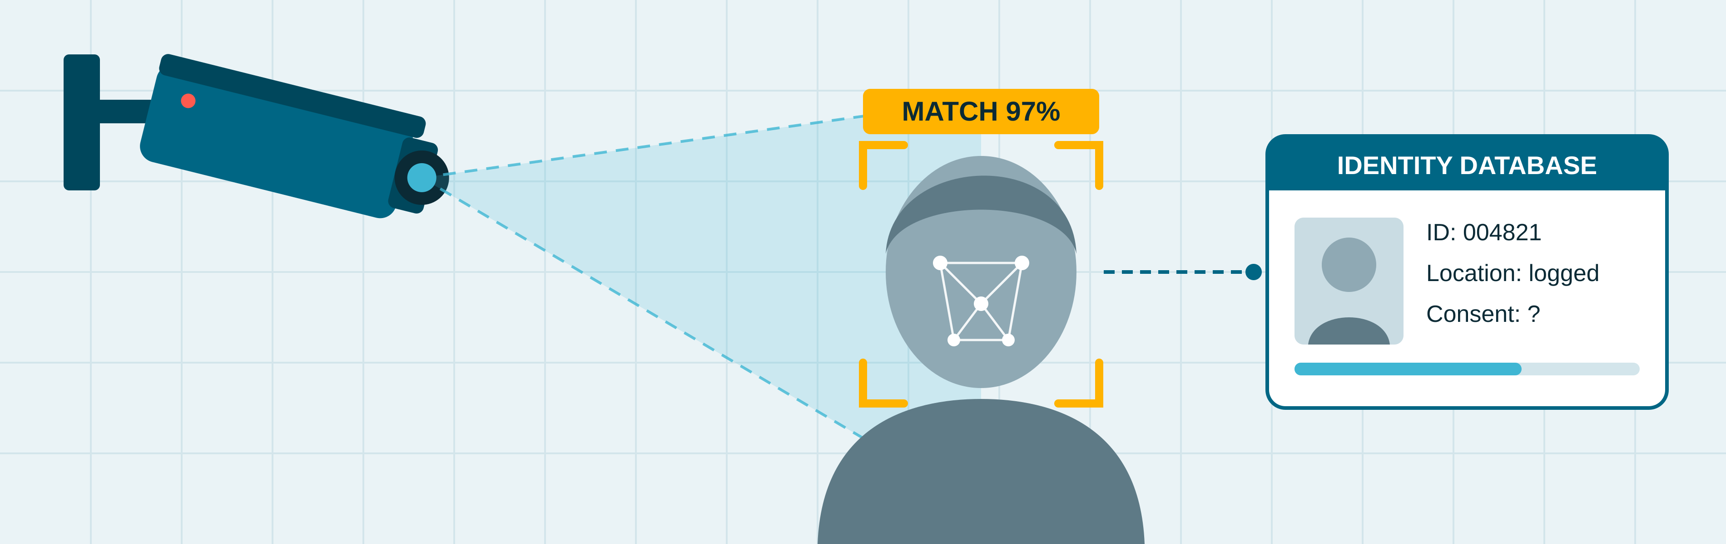
Computer Vision: Ethical, Legal and Social Impacts
Muhammad Asharib
2023478
BSc (Hons) in Computing in IT, CCT College Dublin
What is Computer Vision?
Ethical, Legal & Social Impact
Use Case
Computer vision is a branch of artificial intelligence that enables machines to interpret and understand images and videos (Szeliski, 2022). To a computer, an image is a grid of tiny squares called pixels, each storing a number that represents its colour or brightness. A camera first captures the scene; an AI model, typically a Convolutional Neural Network (CNN), then identifies patterns such as edges, shapes and objects, and finally produces a meaningful output, such as recognising a face (Szeliski, 2022).
The field emerged at MIT in the 1960s, when researchers first attempted to teach computers to perceive three-dimensional objects (Roberts, 1963). In the 1990s, CNNs learned to read handwritten digits (LeCun et al., 1998), and in 2012 deep learning dramatically improved object recognition (Krizhevsky, Sutskever and Hinton, 2012).
Key applications include:
Facial recognition and smartphone unlocking
Self-driving cars
Intelligent security cameras
Medical imaging and skin-cancer detection (Esteva et al., 2017)
Computer vision offers significant benefits to society. In healthcare, deep learning models can classify skin cancer with accuracy comparable to dermatologists, supporting earlier diagnosis (Esteva et al., 2017). It also improves safety and accessibility through driver-assistance systems and apps that describe surroundings to visually impaired users (Manduchi and Coughlan, 2012). These benefits suggest that, when used responsibly, the technology can help save lives.
However, it also raises serious ethical concerns. Commercial facial analysis systems misclassified the gender of darker-skinned women up to 34.7% of the time, compared with 0.8% for lighter-skinned men (Buolamwini and Gebru, 2018). If similar errors occur in policing, innocent people could be wrongly suspected. Privacy is another risk: unlike a password, a face cannot be changed, yet it can be tracked without consent. Socially, constant monitoring risks normalising surveillance and weakening personal autonomy (Zuboff, 2019).
Legally, the GDPR classifies biometric data used for identification as "special category" data requiring stronger protection (European Union, 2016). The EU AI Act goes further, largely prohibiting real-time facial recognition in public spaces for law enforcement (European Union, 2024). As both laws apply in Ireland, this suggests regulation is beginning to catch up with the technology.
In January 2020, Detroit police arrested Robert Williams, a Black man, at his home in front of his family (Hill, 2020). A facial recognition system had wrongly matched his driving licence photo to CCTV footage of a shoplifting incident, and he was detained overnight for a crime he did not commit.
This case illustrates the bias Buolamwini and Gebru (2018) had already warned about. Officers trusted the algorithm without proper human verification, harming an innocent family. In 2024, Detroit agreed to pay $300,000 and banned arrests based solely on facial recognition results (White, 2024). This demonstrates that technology must not replace human judgement.
Mitigation
The Williams case shows that computer vision should support, not replace, human decisions. First, police should treat facial recognition matches only as leads requiring officer verification (White, 2024). Second, developers must test systems on diverse datasets to reduce bias (Buolamwini and Gebru, 2018). Third, regulation such as the EU AI Act, backed by independent audits, can limit misuse (European Union, 2024). Finally, greater transparency would build public trust, increasing benefits in healthcare and accessibility.
Camera
captures the image
Pixels
image as numbers
CNN
AI model finds patterns
Result
e.g. face recognised
References
Buolamwini, J. and Gebru, T. (2018) ‘Gender shades: intersectional accuracy disparities in commercial gender classification’, Proceedings of the 1st Conference on Fairness, Accountability and Transparency, PMLR 81, pp. 77–91.
Esteva, A., Kuprel, B., Novoa, R.A., Ko, J., Swetter, S.M., Blau, H.M. and Thrun, S. (2017) ‘Dermatologist-level classification of skin cancer with deep neural networks’, Nature, 542(7639), pp. 115–118.
European Union (2016) General Data Protection Regulation (EU) 2016/679. Official Journal of the European Union, L 119.
European Union (2024) Artificial Intelligence Act (EU) 2024/1689. Official Journal of the European Union, L series.
Hill, K. (2020) ‘Wrongfully accused by an algorithm’, The New York Times, 24 June. Available at: https://www.nytimes.com/2020/06/24/technology/facial-recognition-arrest.html (Accessed: 16 October 2026).
Krizhevsky, A., Sutskever, I. and Hinton, G.E. (2012) ‘ImageNet classification with deep convolutional neural networks’, Advances in Neural Information Processing Systems, 25, pp. 1097–1105.
LeCun, Y., Bottou, L., Bengio, Y. and Haffner, P. (1998) ‘Gradient-based learning applied to document recognition’, Proceedings of the IEEE, 86(11), pp. 2278–2324.
Manduchi, R. and Coughlan, J. (2012) ‘(Computer) vision without sight’, Communications of the ACM, 55(1), pp. 96–104.
Roberts, L.G. (1963) Machine perception of three-dimensional solids. PhD thesis. Massachusetts Institute of Technology.
Szeliski, R. (2022) Computer vision: algorithms and applications. 2nd edn. Cham: Springer.
White, E. (2024) ‘Detroit paying $300,000 to man wrongly accused of theft, making changes in use of facial technology’, Associated Press, 28 June. Available at: https://www.news4jax.com/tech/2024/06/28/detroit-paying-300000-to-man-wrongly-accused-of-theft-making-changes-in-use-of-facial-technology/ (Accessed: 16 October 2026).
Zuboff, S. (2019) The age of surveillance capitalism: the fight for a human future at the new frontier of power. London: Profile Books.
Fig. 1 How computer vision works (own diagram)
Fig. 2 Facial recognition matching a face to an identity database (own illustration)
Our Dedication.Your Journey.
www.cct.ie

